Slide 1
Presenting and storytelling with data
Sean McMinn
Digital frameworks
Northwestern University – Summer 2018
Github.com/shmcminn/digitalframeworks-summer18

Slide 2
Data stories?

Slide 3
Steps to a data story
Find data
Clean data
Analyze data
Present data

Slide 4
Agenda
Types of data presentation
Titanic exercise
Tableau training

Slide 5
Storytelling forms
What have you seen on the web?

Slide 6
Storytelling forms
What have you seen on the air?

Slide 7
Storytelling forms
What have you seen on the air?

Slide 8
Storytelling forms
Alternative storytelling forms
Get people associating information with visuals
Delivers information in bite-sized chunks
Makes the news more accessible

Slide 9
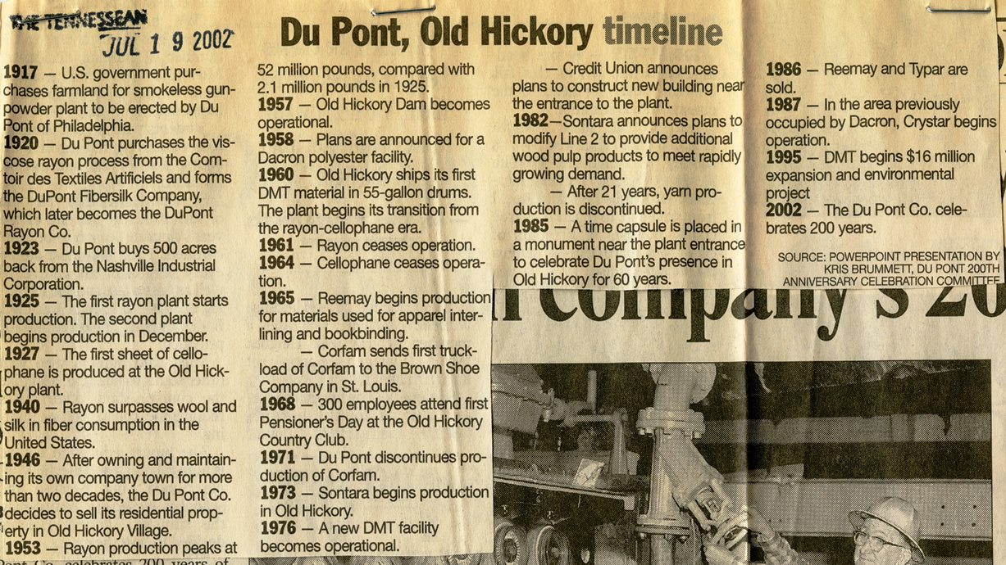
Storytelling forms
Alternative storytelling forms
They’re not new

Slide 10
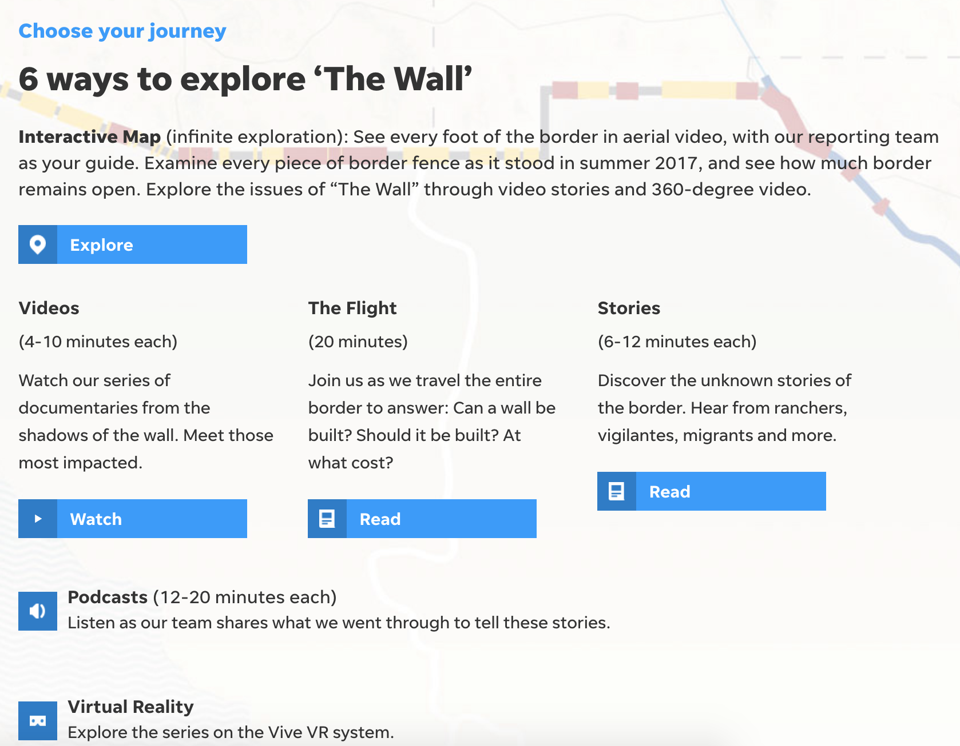
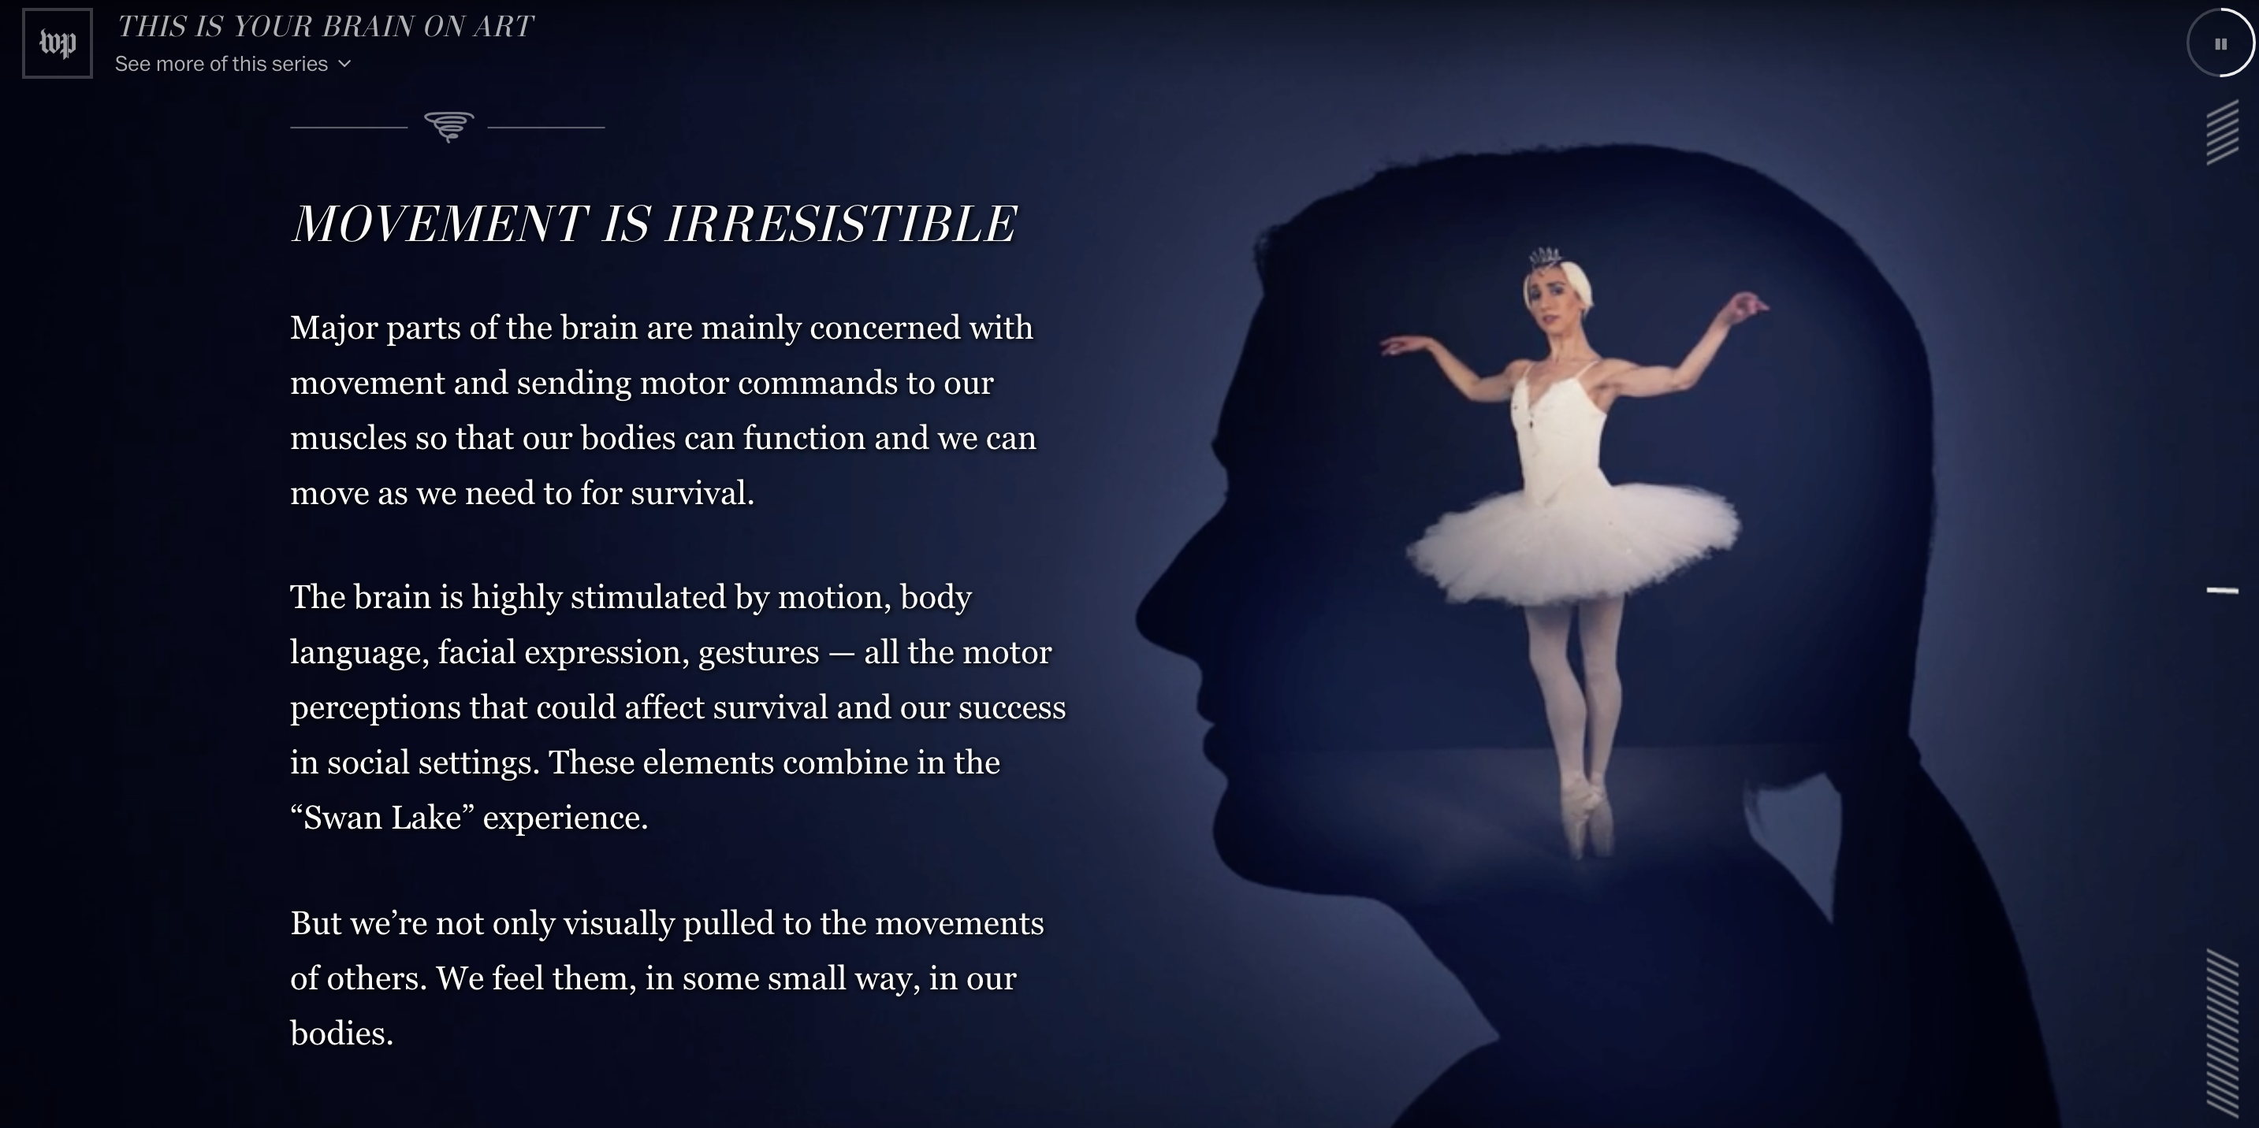
Storytelling forms
Can be data viz, but don’t have to be

Slide 11
Storytelling forms
Scrollytelling
Can make long text feel short
https://www.nytimes.com/interactive/2014/09/14/sports/baseball/jeter-swings.html?mtrref=vallandingham.me
https://www.nytimes.com/interactive/2015/01/09/sports/the-dawn-wall-el-capitan.html?mtrref=vallandingham.me
https://www.washingtonpost.com/graphics/2017/lifestyle/your-brain-on-art/?utm_term=.154307ea6929

Slide 12
Storytelling forms
Small data to big data
Tell people a story, then give them option to explore
https://www.themarshallproject.org/next-to-die
https://projects.fivethirtyeight.com/redistricting-maps/arkansas/#Proportional

Slide 13
Storytelling forms
Games
Entertaining way to interact with data
https://wamu.org/commuter-challenge/
http://www.redistrictinggame.org/game.php

Slide 14
Storytelling forms
Exploring individual data points
https://www.washingtonpost.com/graphics/2018/national/mass-shootings-in-america/?utm_term=.d9db61664e3
https://www.washingtonpost.com/graphics/world/syria-220000/

Slide 15
Storytelling forms
Broadcast
Find persons who story affect
https://www.youtube.com/watch?t=6&v=zIGLZpjqubM

Slide 16

Storytelling forms
Broadcast
Radio: “visualize” data instead of reciting statistics
http://wfpl.org/a-curious-louisville-news-special-your-questions-about-the-jcps-audit/

Slide 17


Slide 18
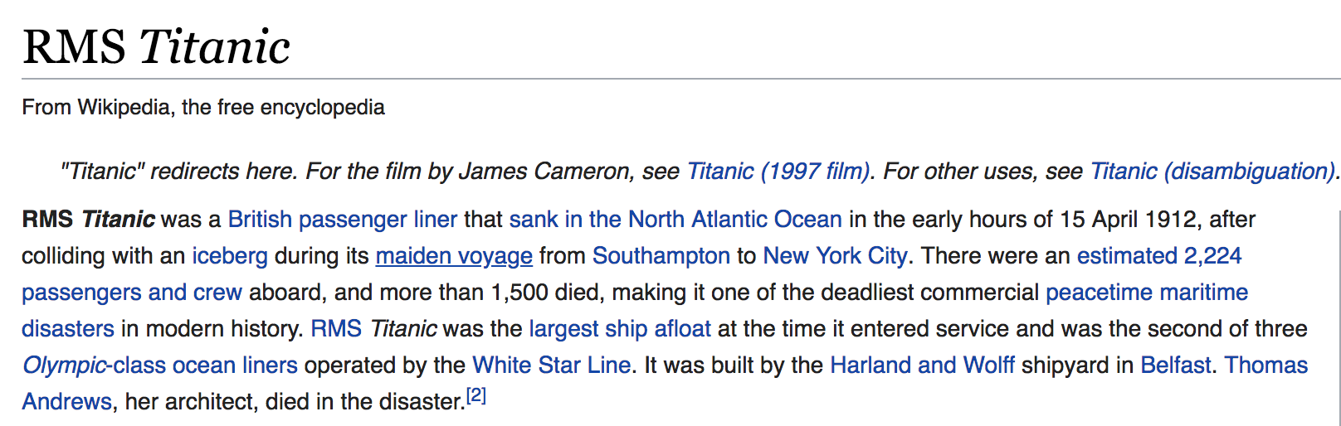

Slide 19



Take one passenger
You are responsible for making sure this person’s story is told

Slide 20
Data presentation ideas

Slide 21
